Slide 1
CHAPTER 14
FUZZY LOGIC CONTROL SYSTEMS
“Principles of Soft Computing, 2nd Edition”
by S.N. Sivanandam & SN Deepa
Copyright © 2011 Wiley India Pvt. Ltd. All rights reserved.

Slide 2
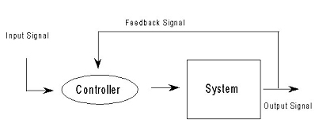
CONTROL SYSTEM
Any system whose outputs are controlled by some inputs to the system is called a control system.
“Principles of Soft Computing, 2nd Edition”
by S.N. Sivanandam & SN Deepa
Copyright © 2011 Wiley India Pvt. Ltd. All rights reserved.

Slide 3
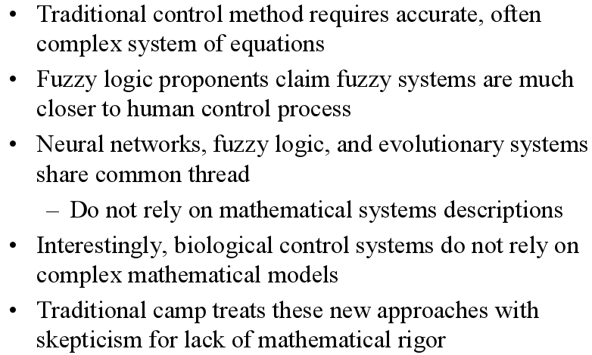
TRADITIONAL vs FUZZY LOGIC CONTROLLERS (FLC)
“Principles of Soft Computing, 2nd Edition”
by S.N. Sivanandam & SN Deepa
Copyright © 2011 Wiley India Pvt. Ltd. All rights reserved.

Slide 4
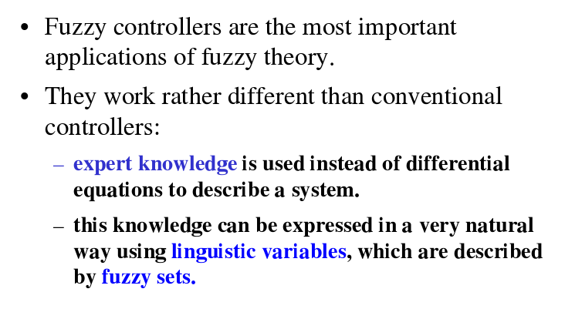
FUZZY CONTROL
“Principles of Soft Computing, 2nd Edition”
by S.N. Sivanandam & SN Deepa
Copyright © 2011 Wiley India Pvt. Ltd. All rights reserved.

Slide 5
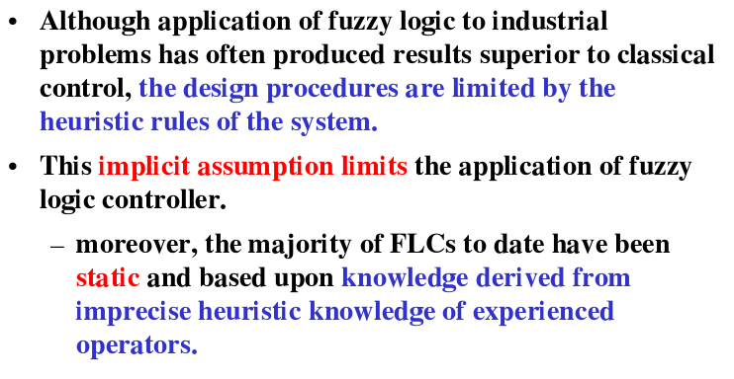
FUZZY LOGIC CONTROLLERS (FLC)
“Principles of Soft Computing, 2nd Edition”
by S.N. Sivanandam & SN Deepa
Copyright © 2011 Wiley India Pvt. Ltd. All rights reserved.

Slide 6
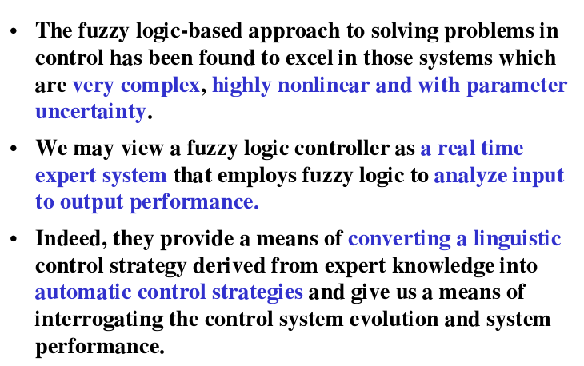
“Principles of Soft Computing, 2nd Edition”
by S.N. Sivanandam & SN Deepa
Copyright © 2011 Wiley India Pvt. Ltd. All rights reserved.

Slide 7
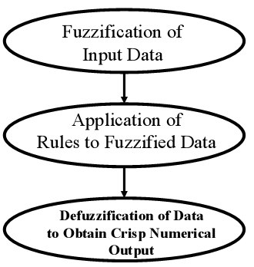
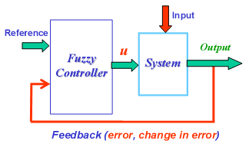
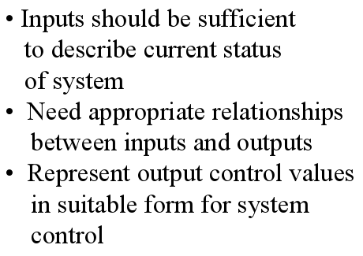
“Principles of Soft Computing, 2nd Edition”
by S.N. Sivanandam & SN Deepa
Copyright © 2011 Wiley India Pvt. Ltd. All rights reserved.

Slide 8
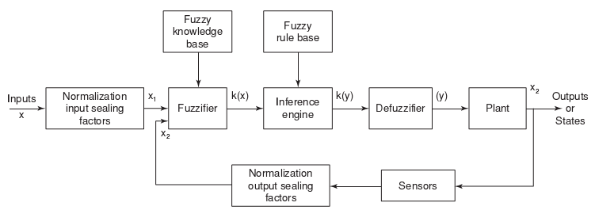
ARCHITECTURE OF FLC
“Principles of Soft Computing, 2nd Edition”
by S.N. Sivanandam & SN Deepa
Copyright © 2011 Wiley India Pvt. Ltd. All rights reserved.

Slide 9
DESCRIPTION OF FLC COMPONENTS
A Fuzzy Logic Controller usually consists of:
A fuzzification unit which maps measured inputs of crisp value into fuzzy linguistic values to be used by a fuzzy reasoning mechanism.
A knowledge base (KB) which is the collection of expert control knowledge required to achieve the control objective.
A fuzzy reasoning mechanism that performs various fuzzy logic operations to infer the control action for the given fuzzy inputs.
A defuzzification unit which converts the inferred fuzzy control action into the required crisp control values to be entered into the system process.
“Principles of Soft Computing, 2nd Edition”
by S.N. Sivanandam & SN Deepa
Copyright © 2011 Wiley India Pvt. Ltd. All rights reserved.

Slide 10
FUZZY LOGIC CONTROLLER
Control inputs,
Fuzzy sets (membership functions) of inputs,
Rules,
Control outputs,
Fuzzy sets (membership functions) of outputs,
Fuzzy reasoning,
Defuzzification.
“Principles of Soft Computing, 2nd Edition”
by S.N. Sivanandam & SN Deepa
Copyright © 2011 Wiley India Pvt. Ltd. All rights reserved.

Slide 11
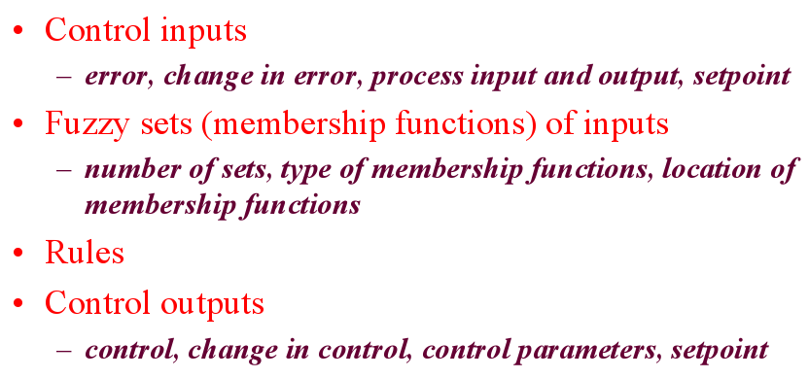
“Principles of Soft Computing, 2nd Edition”
by S.N. Sivanandam & SN Deepa
Copyright © 2011 Wiley India Pvt. Ltd. All rights reserved.

Slide 12
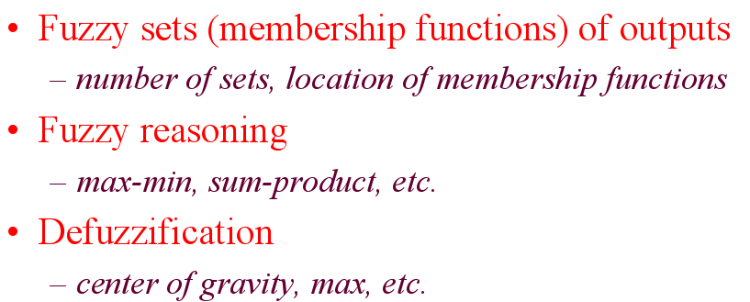
“Principles of Soft Computing, 2nd Edition”
by S.N. Sivanandam & SN Deepa
Copyright © 2011 Wiley India Pvt. Ltd. All rights reserved.

Slide 13
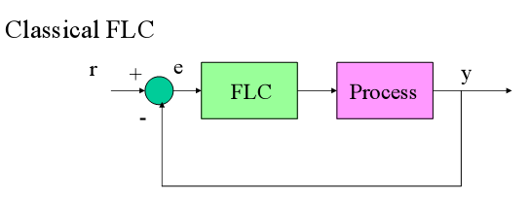
CLASSICAL FUZZY LOGIC CONTROLLER
“Principles of Soft Computing, 2nd Edition”
by S.N. Sivanandam & SN Deepa
Copyright © 2011 Wiley India Pvt. Ltd. All rights reserved.

Slide 14
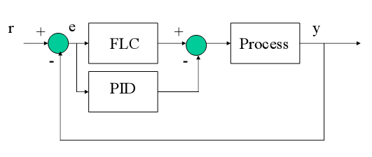
FUZZY LOGIC CONTROLLER (FLC) AND CONVENTIONAL PROPORTIOANL INTEGRAL DERIVATIVE (PID)
“Principles of Soft Computing, 2nd Edition”
by S.N. Sivanandam & SN Deepa
Copyright © 2011 Wiley India Pvt. Ltd. All rights reserved.

Slide 15
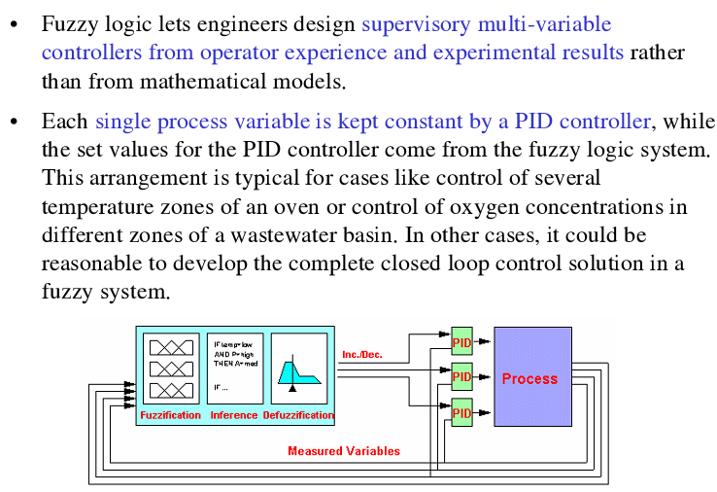
FLC AND PID CONTROLLERS
“Principles of Soft Computing, 2nd Edition”
by S.N. Sivanandam & SN Deepa
Copyright © 2011 Wiley India Pvt. Ltd. All rights reserved.

Slide 16
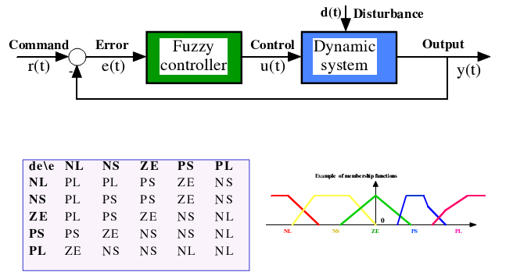
FUZZY LOGIC CONTROLLER (MAMDANI)
“Principles of Soft Computing, 2nd Edition”
by S.N. Sivanandam & SN Deepa
Copyright © 2011 Wiley India Pvt. Ltd. All rights reserved.

Slide 17
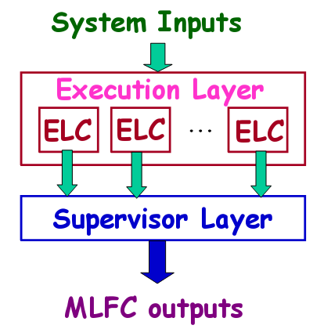
MULTILAYER FUZZY LOGIC CONTROLLER (MLFLC)
“Principles of Soft Computing, 2nd Edition”
by S.N. Sivanandam & SN Deepa
Copyright © 2011 Wiley India Pvt. Ltd. All rights reserved.

Slide 18
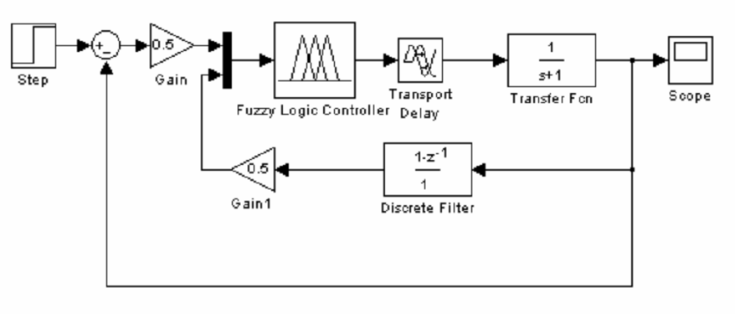
MATLAB SCREENSHOT OF FLC - SIMULINK BLOCK
“Principles of Soft Computing, 2nd Edition”
by S.N. Sivanandam & SN Deepa
Copyright © 2011 Wiley India Pvt. Ltd. All rights reserved.

Slide 19
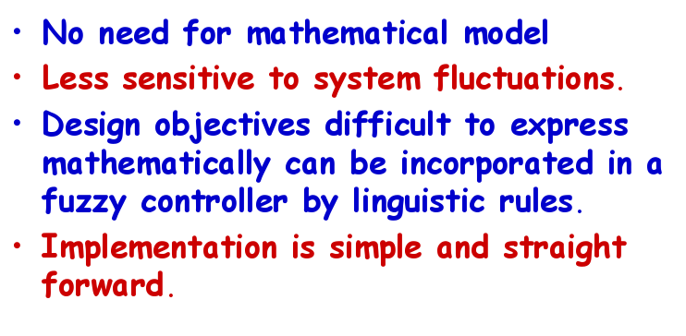
ADVANTAGES OF FLC
“Principles of Soft Computing, 2nd Edition”
by S.N. Sivanandam & SN Deepa
Copyright © 2011 Wiley India Pvt. Ltd. All rights reserved.

Slide 20
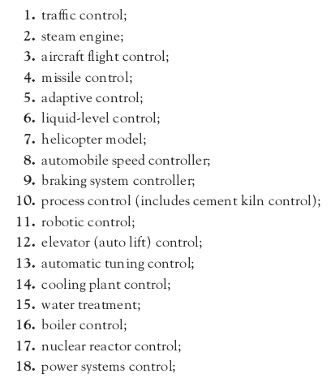
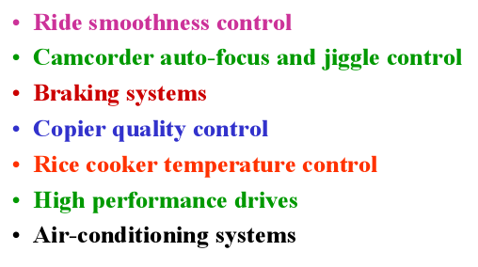
APPLICATIONS OF FLC
“Principles of Soft Computing, 2nd Edition”
by S.N. Sivanandam & SN Deepa
Copyright © 2011 Wiley India Pvt. Ltd. All rights reserved.

Slide 21
SUMMARY
Easy to set up a working fuzzy controller even for difficult-to-control processes (but previously controlled by operator).
Easy to understand the rule base in simple cases.
No need to use FLC in straightforward linear cases, if implementation reasons would not require it.
Complications will arise when rule base increases.
“Principles of Soft Computing, 2nd Edition”
by S.N. Sivanandam & SN Deepa
Copyright © 2011 Wiley India Pvt. Ltd. All rights reserved.

